Slide 1
Lesson 2
Mitosis

Slide 2
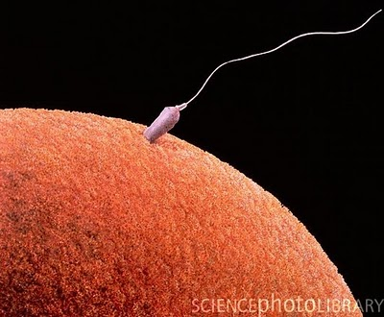
We all started from a single cell that was formed when our mother’s sex cell (egg/ovum) combined with our father’s sex cell (sperm/spermatozoa). That one cell has then multiplied trillions of times to make the person you are today.
Each of those cells carries the exact same DNA.

Slide 3
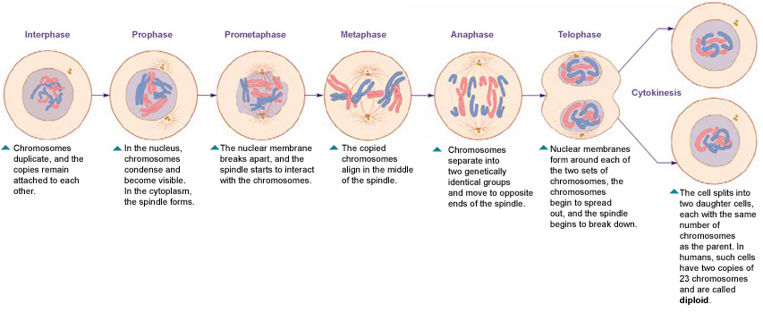
Cells in our body multiply through a process called mitosis. There are many different steps in mitosis, we need to know the six main steps.

Slide 4
Phase 1: Interphase
Chromosomes are copied. The DNA found inside the nucleus is copied so the cell will contain two sets of identical DNA (information needed to build a person)

Slide 5
Phase 1: Interphase
Chromosomes are copied. The DNA found inside the nucleus is copied so the cell will contain two sets of identical DNA (information needed to build a person)

Slide 6
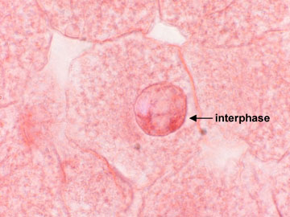
Phase 1: Interphase
Chromosomes are copied. The DNA found inside the nucleus is copied so the cell will contain two sets of identical DNA (information needed to build a person)

Slide 7
Phase 1: Interphase
Diagram:

Slide 8
Phase 2: Prophase
The wall that separates the nucleus from the rest of the cell begins to break down. Centrioles move to opposite ends of the cell and start forming spindles.

Slide 9
Phase 2: Prophase
The wall that separates the nucleus form the rest of the cell begins to break down. Centrioles move to opposite ends of the cell and start forming spindles.

Slide 10
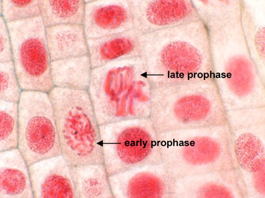
Phase 2: Prophase
The wall that separates the nucleus form the rest of the cell begins to break down. Centrioles move to opposite ends of the cell and start forming spindles.

Slide 11
Phase 2: Prophase
Diagram:

Slide 12
Phase 3: Metaphase
The spindles connect to the chromosomes. The chromosomes are then lined up in the middle of the cell.

Slide 13
Phase 3: Metaphase
The spindles connect to the chromosomes. The chromosomes are then lined up in the middle of the cell.

Slide 14
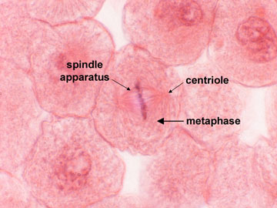
Phase 3: Metaphase
The spindles connect to the chromosomes. The chromosomes are then lined up in the middle of the cell.

Slide 15
Phase 3: Metaphase
Diagram:

Slide 16
Phase 4: Anaphase
The DNA is separated. The centrioles pull the DNA and its copy apart, directing it to opposite sides of the cell by the centriole’s spindles.

Slide 17
Phase 4: Anaphase
The DNA is separated. The centrioles pull the DNA and its copy apart, directing it to opposite sides of the cell by the centriole’s spindles.

Slide 18
Phase 4: Anaphase
The DNA is separated. The centrioles pull the DNA and its copy apart, directing it to opposite sides of the cell by the centriole’s spindles.

Slide 19
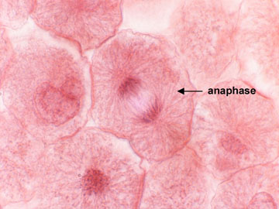
Phase 4: Anaphase
The DNA is separated. The centrioles pull the DNA and its copy apart, directing it to opposite sides of the cell by the centriole’s spindles.

Slide 20
Phase 4: Anaphase
Diagram:

Slide 21
Phase 5: Telophase
Nuclear membrane begins to form (nuclear membrane is a wall that will separate the nucleus from the rest of the cell)
*In this diagram, the 6th stage can already been seen; cytokinesis (separation into two individual cells)

Slide 22
Phase 5: Telophase
Nuclear membrane begins to form (nuclear membrane is a wall that will separate the nucleus from the rest of the cell)
*In this diagram, the 6th stage can already been seen; cytokinesis (separation into two individual cells)

Slide 23
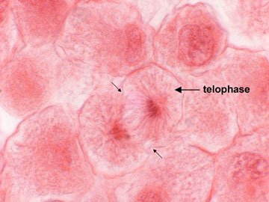
Phase 5: Telophase
Nuclear membrane begins to form (nuclear membrane is a wall that will separate the nucleus from the rest of the cell)
*In this diagram, the 6th stage can already been seen; cytokinesis (separation into two individual cells)

Slide 24
Phase 5: Telophase
Diagram

Slide 25
Phase 6: Cytokinesis
The cell will separate into two cells, each with a nucleus which contains identical DNA

Slide 26
Phase 6: Cytokinesis
The cell will separate into two cells, each with a nucleus which contains identical DNA.

Slide 27
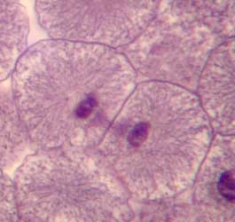
Phase 6: Cytokinesis
The cell will separate into two cells, each with a nucleus which contains identical DNA.

Slide 28
Phase 6: Cytokinesis
Diagram:

Slide 29
Assignment
There will be a quiz tomorrow,
you must be able to;
give the name of each phase
know the order of the phases
know what happens in each phase
The next slide will help you develop a strategy to remember the 6 stages of mitosis.

Slide 30
I
Prefer
My
Awesome
Team
Cincinnati

Slide 31
Interphase
Prophase
Metaphase
Anaphase
Telophase
Cytokinesis

Slide 32
Assignment
Come up with your own saying to help you remember the stages in order…or use mine.
Spend the rest of the period studying in pairs.
Practice writing all the names in order on a piece of paper without prompting.
Once that becomes easy, start quizzing one another on what happens in each stage.
Study tonight and make sure to get to class before the bell and review before the quiz.

Slide 33
fin

